Slide 1


Scientific Machine Learning
Lecture 9: PINN for Inverse Problems
孟旭辉
数学与统计学院数学与应用学科交叉创新研究院
办公室：欣苑2栋111室
Email：xuhui_meng@hust.edu.cn
https://github.com/XuhuiM/SciML-Course
4/7/2023

Slide 2
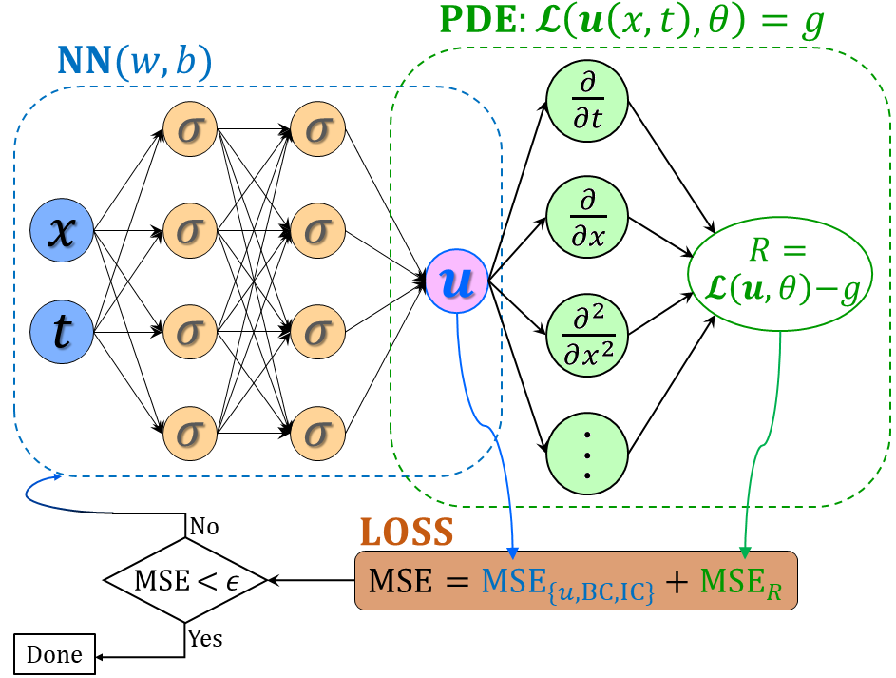
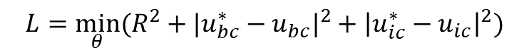

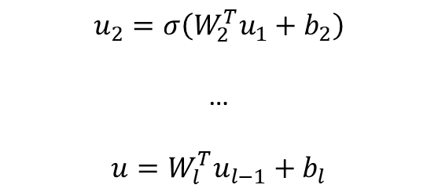

From DNNs to PINNs
$$u_{1}=σ(W_{1}^{T}X+b_{1})$$
(1)
$$u_{2}=σ\left(W_{2}^{T}u_{1}+b_{2}\right)$$
…
$$u=W_{l}^{T}u_{l−1}+b_{l}$$
(2) PDE part: Chain rule
$$∂_{t}u, ∂_{x}u, …$$
Physics-informed neural networks (PINNs)
Loss function:
Forward problem:
$$L={\min_{θ}⁡(R^{2}+|u_{bc}^{∗}−u_{bc}|}^{2}+{\left|u_{ic}^{∗}−u_{ic}\right|}^{2})$$
Inverse problem:
$$L={\min_{θ,λ}⁡(R^{2}+|u_{bc}^{∗}−u_{bc}|}^{2}+{\left|u_{ic}^{∗}−u_{ic}\right|}^{2}+{\left|u^{∗}−u\right|}^{2})$$
Raissi, et al, JCP, 2019
Meng, et al, CMAME, 2020

Slide 3
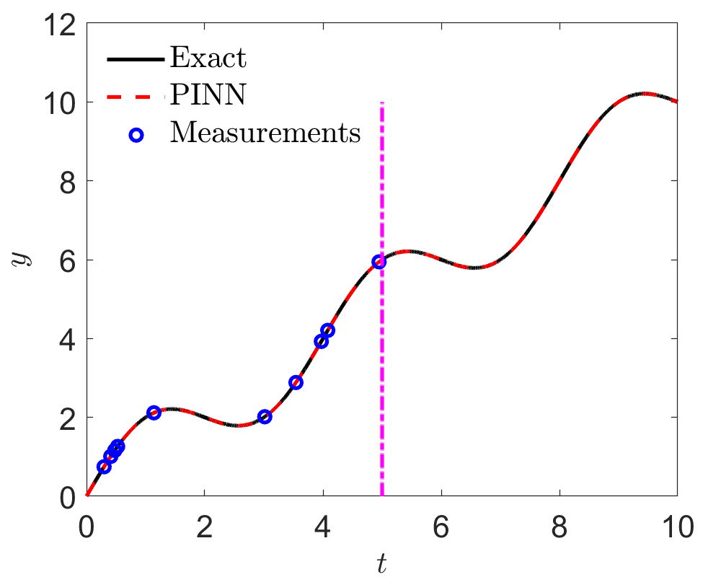
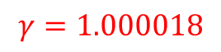
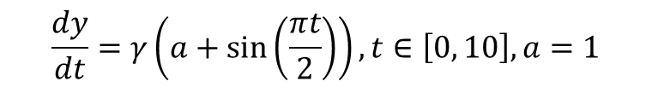

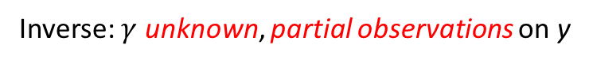
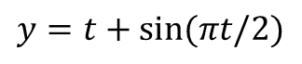
Inverse Problem
$$\frac{dy}{dt}=γ\left(a+\sin\left(\frac{πt}{2}\right)\right), t∈\left[0, 10\right], a=1$$
Inverse: $γ$ unknown, partial observations on y
Solution:
$$y=t+sin(πt/2)$$
Loss:
$$L={\left|R\right|}^{2}+{\left|y_{ic}−y_{ic}^{∗}\right|}^{2}+{\left|y−y^{∗}\right|}^{2}$$
$$γ=1.000018$$

Slide 4
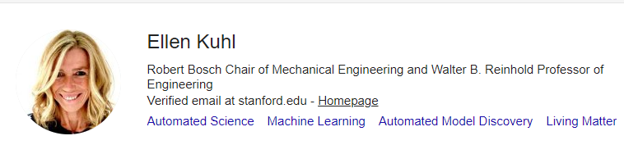
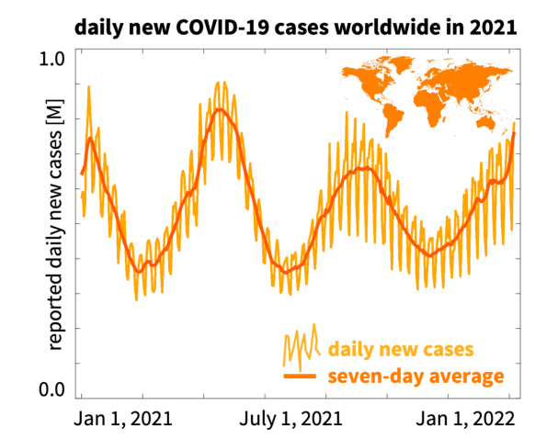
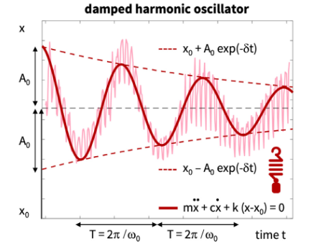
Inverse Problem: Covid-19
$$c\sim O\left(1\right), k\sim O\left(100\right), x_{0}\sim O(0.1)$$
Linka, et al., CMAME, 2022

Slide 5
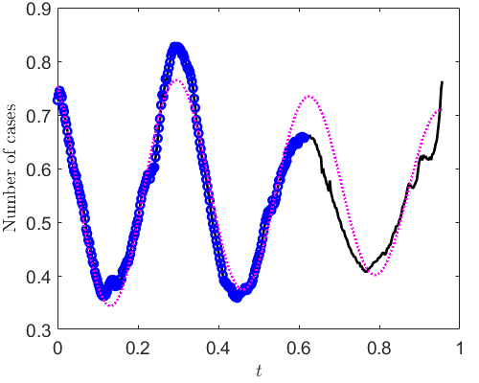
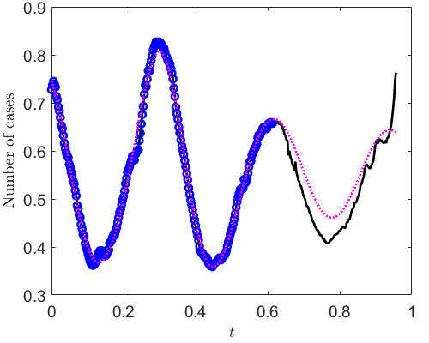
PINNs: Scaling vs no-scaling
Scale all unknowns to O(1)
scaling
PINN can fit the training data better with scaling

Slide 6
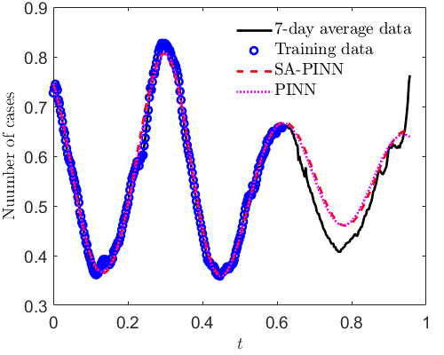
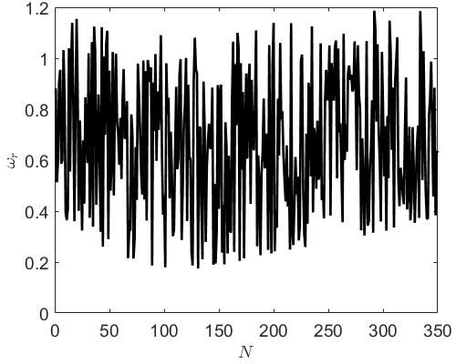
PINNs vs self-adaptive PINNs (SA-PINNs)
Comparison between PINNs and SA-PINNs
Weights for the residuals in SA-PINNs

Slide 7
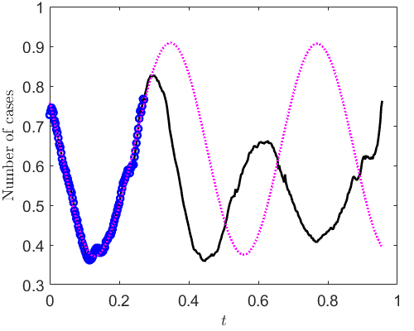
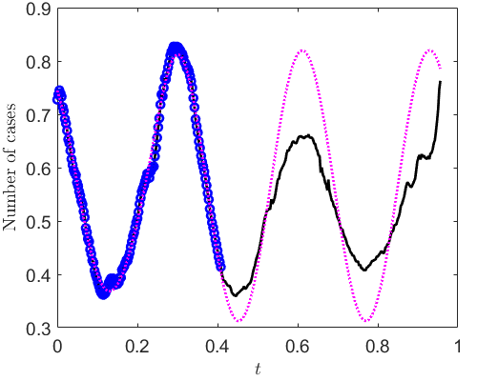
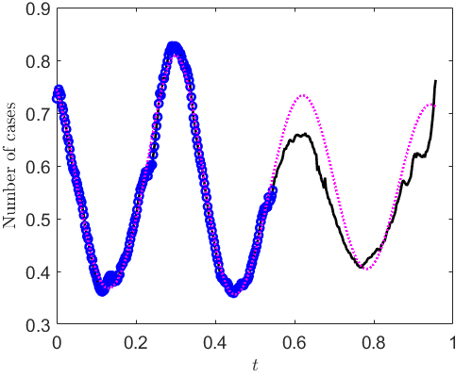
PINNs: Effect of number of training data
100 training points
150 training points
200 training points
225 training points

Slide 8
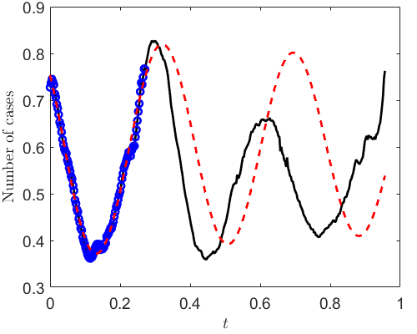

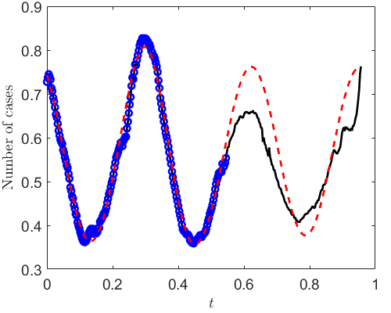
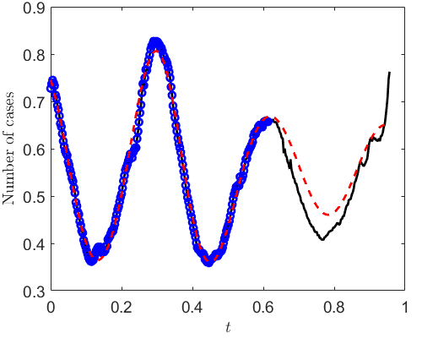
SA-PINNs: Effect of number of training data
100 training points
150 training points
200 training points
225 training points

Slide 9
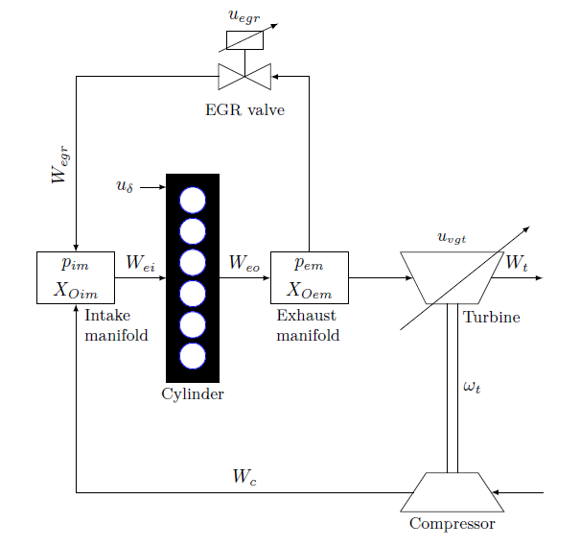
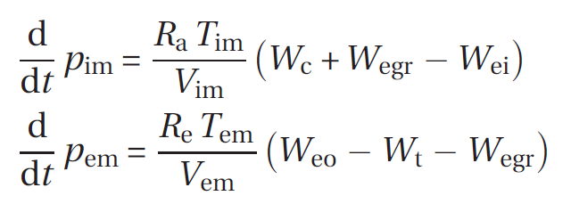
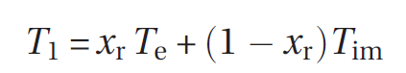
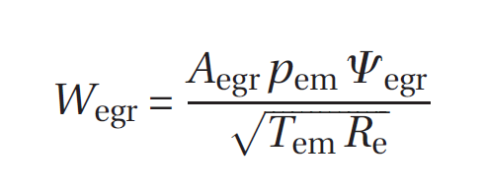
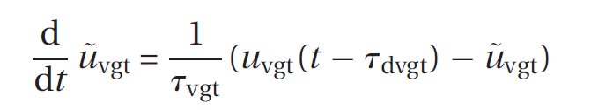
Inverse problem: diesel engines
J Wahlstrom, etc. 2011

Slide 10
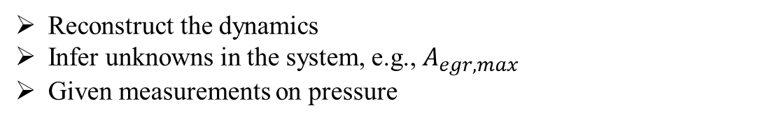
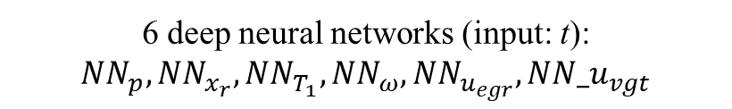
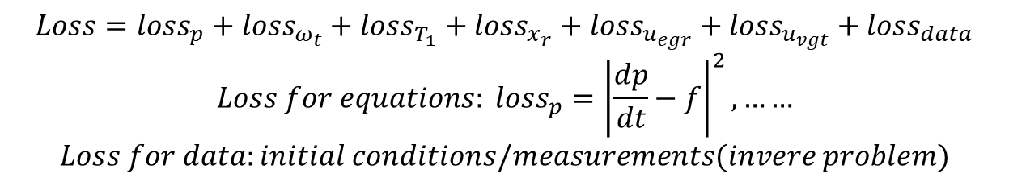
Inverse problem: diesel engines
Reconstruct the dynamics
Infer unknowns in the system, e.g., $A_{egr,max}$
Given measurements on pressure
6 deep neural networks (input: t): $NN_{p}, NN_{x_{r}}, NN_{T_{1}},NN_{ω},NN_{u_{egr}},NN_u_{vgt}$
$$Loss=loss_{p}+loss_{ω_{t}}+loss_{T_{1}}+loss_{x_{r}}+loss_{u_{egr}}+loss_{u_{vgt}}+loss_{data}$$
$$Loss for equations: loss_{p}={\left|\frac{dp}{dt}−f\right|}^{2},……$$
$$Loss for data:initial conditions/measurements(invere problem)$$
J Wahlstrom, etc. 2011

Slide 11
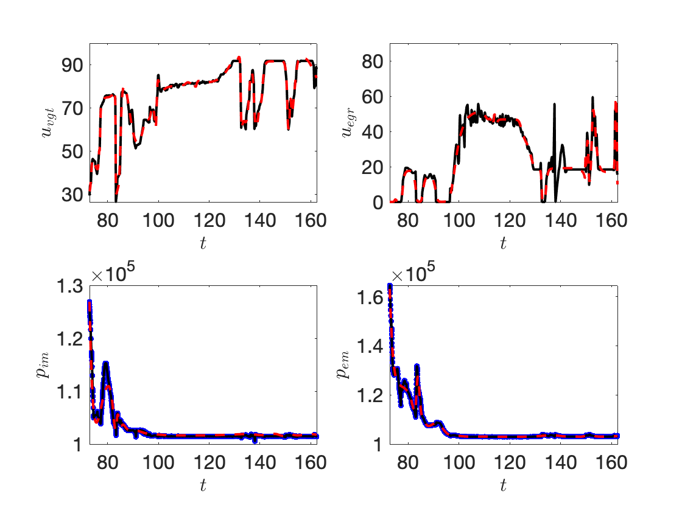
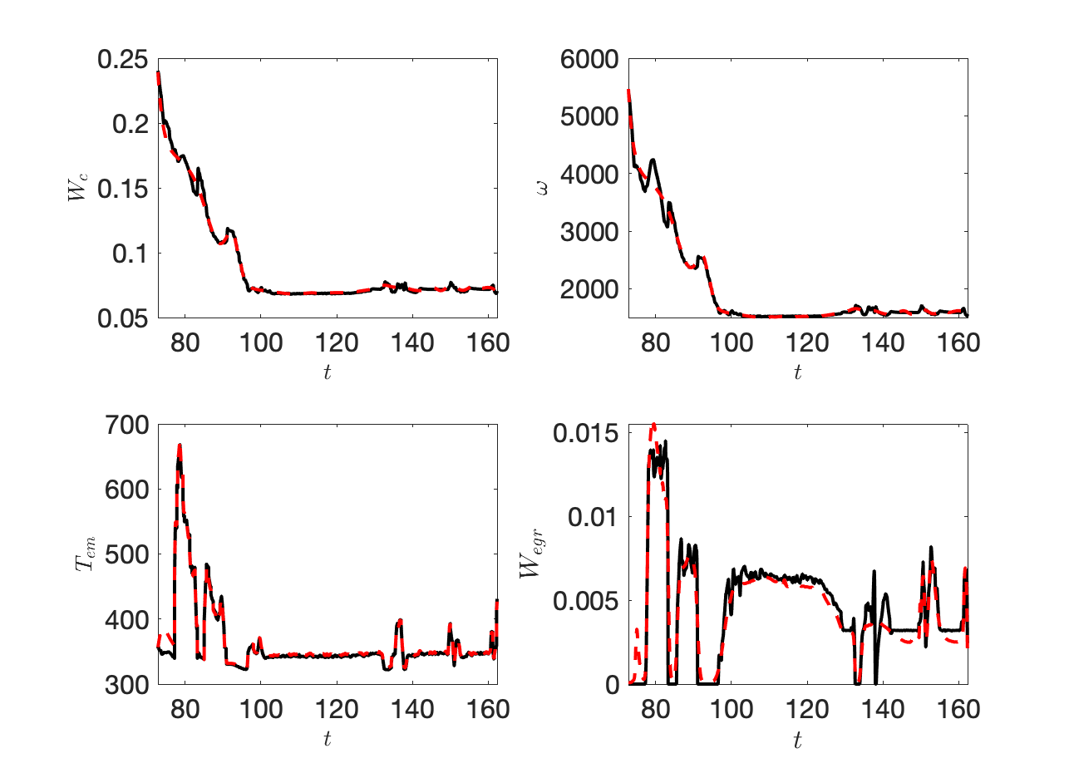
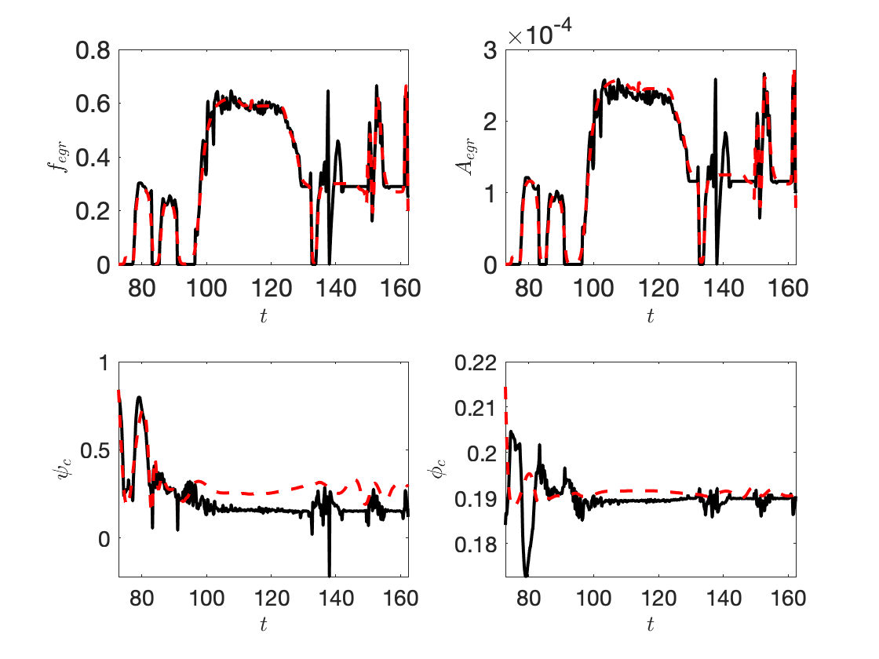
Inverse Problem: diesel engines
PINNs
A_egrmax:
Predicted = 4.160e-4
Reference = 4.0e-4
Error = 4%

Slide 12
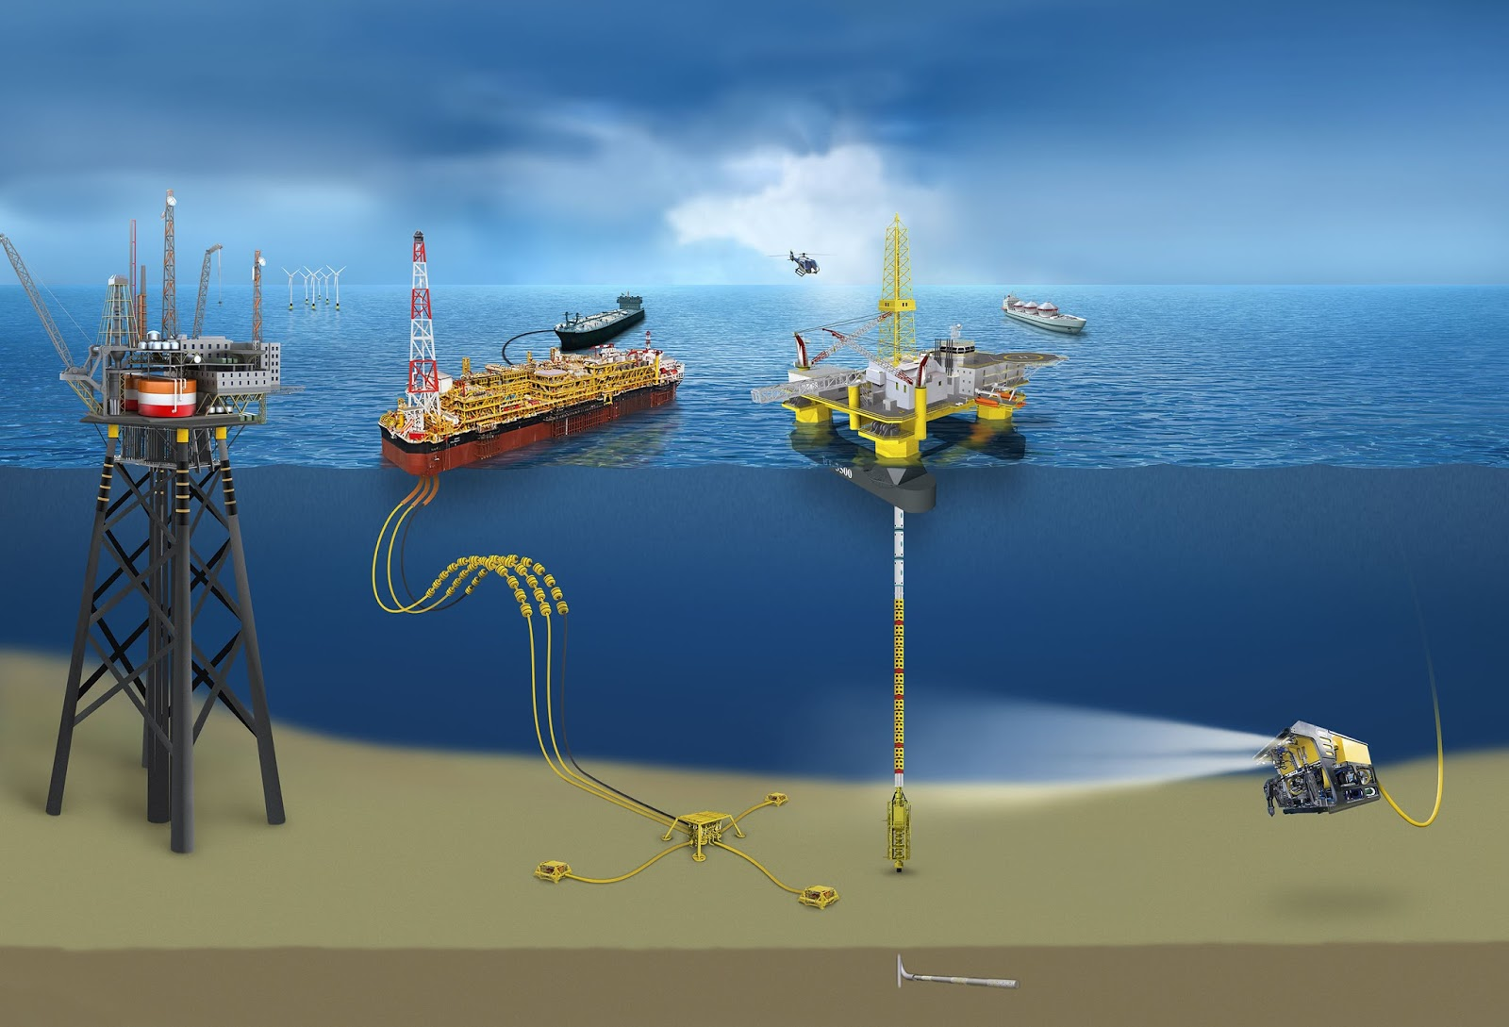
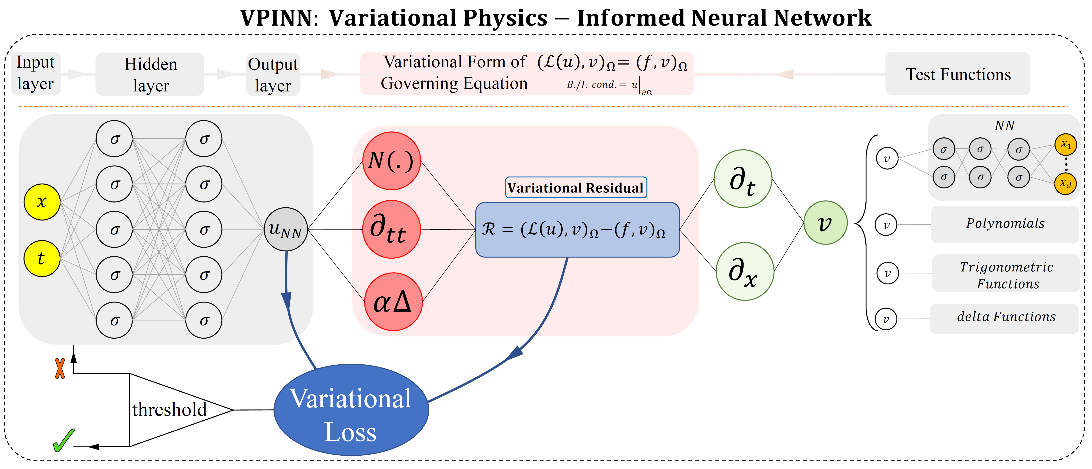

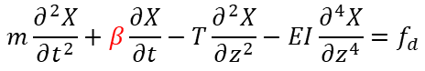

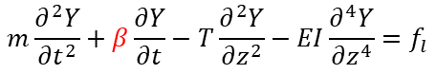
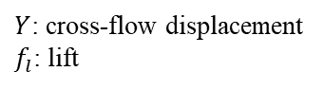

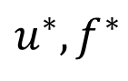
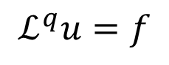
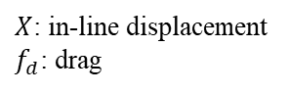
Inverse problem: PINN for VIV
Physical Model:
$$m\frac{∂^{2}Y}{∂t^{2}}+β\frac{∂Y}{∂t}−T\frac{∂^{2}Y}{∂z^{2}}−EI\frac{∂^{4}Y}{∂z^{4}}=f_{l}$$
$Y$: cross-flow displacement
$f_{l}$: lift
$$m\frac{∂^{2}X}{∂t^{2}}+β\frac{∂X}{∂t}−T\frac{∂^{2}X}{∂z^{2}}−EI\frac{∂^{4}X}{∂z^{4}}=f_{d}$$
$X$: in-line displacement
$f_{d}$: drag
Model Parameters
mass per
unit length
damping
coefficient
tension
flexural
rigidity
Distributed damping coefficient: parametrize with a neural network $β\left(z\right)={β }_{NN}(z)$
$$Y$$
Forward
$$X$$
Physics
Data
Current
$$ℒ^{q}u=f$$
$$u^{∗},f^{∗}$$
$$z$$
$$y$$
Inverse
$$x$$
Kharazmi et al, JFS, 2020

Slide 13
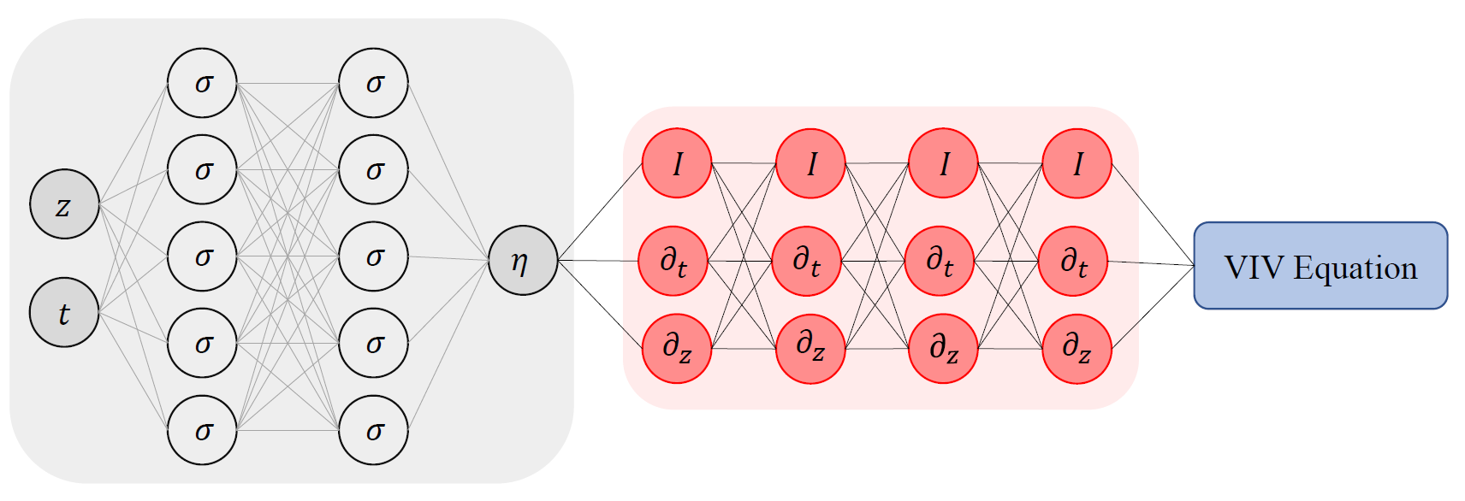
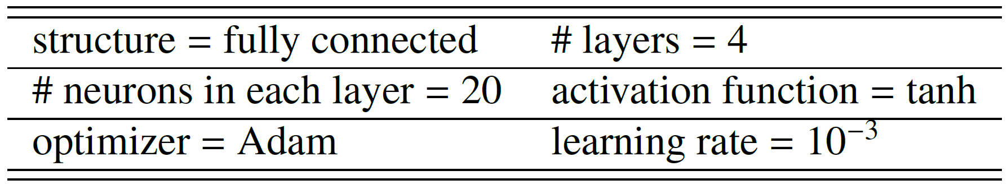

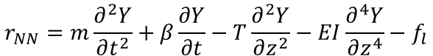
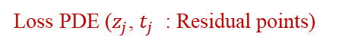
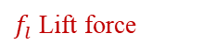
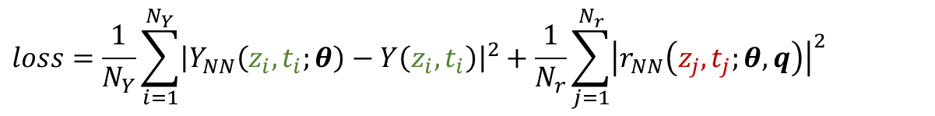

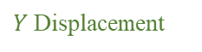
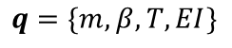
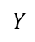
Inverse problem: PINN for VIV
[Kharazmi et al, JFS, 2020 ]
Network Parameters
sine
$$Y$$
NN parameters:
$$θ$$
Model parameters:
$$q=\{m,β,T,EI\}$$
PDE residual:
$$r_{NN}=m\frac{∂^{2}Y}{∂t^{2}}+β\frac{∂Y}{∂t}−T\frac{∂^{2}Y}{∂z^{2}}−EI\frac{∂^{4}Y}{∂z^{4}}−f_{l}$$
$$loss=\frac{1}{N_{Y}}\sum_{i=1}^{N_{Y}}{{\left|Y_{NN}\left(z_{i},t_{i};θ\right)−Y\left(z_{i},t_{i}\right)\right|}^{2}}+\frac{1}{N_{r}}\sum_{j=1}^{N_{r}}{{\left|r_{NN}\left(z_{j},t_{j};θ,q\right)\right|}^{2}}$$
Loss function:
Loss $Y$ ($z_{i}$, $t_{i}$ : Training points)
Loss PDE ($z_{j}$, $t_{j}$ : Residual points)
$Y$Displacement
$f_{l}$ Lift force

Slide 14
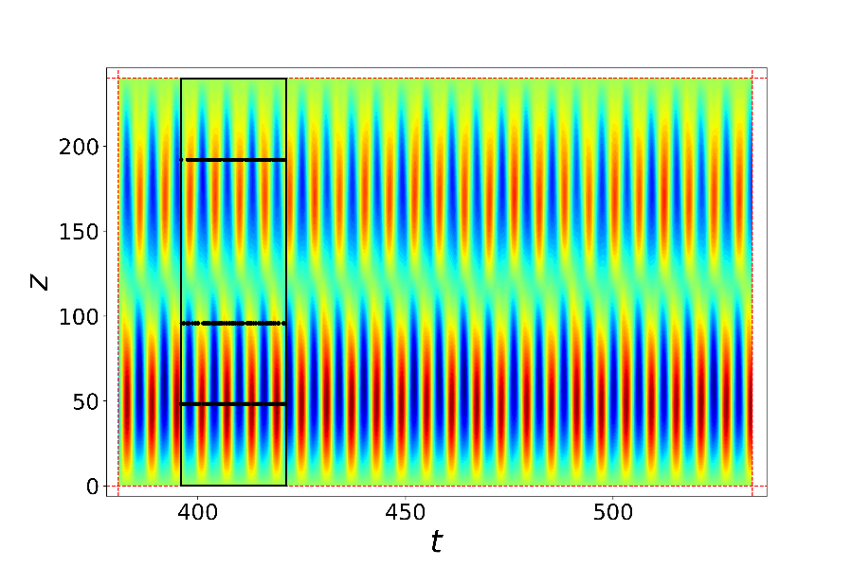



Inverse problem: PINN for VIV
sensor 3
sensor 2
sensor 1
sensor 3
sensor 2
The response with significant noise in the input.
$20\%$added noise to the lift force.
Mean/std is based on$30$realizations.
sensor 1

Slide 15




Super resolution
Forward:
Inverse:
Lou & Meng, et al. JCP, 2021

Slide 16





Super resolution
Micro Couette flow
Micro Cavity flow
Kn=0.1
Kn=10
Lou & Meng, et al. JCP, 2021

Slide 17






PINN for Inverse Problems: Flow Over an Espresso Cup
Tomo-BOS （层析背景纹影）实验，六个相机，可重构三维的温度场。
PINNs以温度场作为训练数据，计算出三维+时间变化的速度和压力。
background-oriented schlieren (BOS)
Temperature
velocity
pressure
Flow over an espresso cup - Cai et al. JFM, 2021

Slide 18





Inverse PDE problems
$$∂_{t}T+u ⋅∇T=α∇^{2}T$$

Slide 19



Inverse PDE problems
$$∂_{t}T+u ⋅∇T=α∇^{2}T$$
Flow over an espresso cup - Cai et al. JFM, 2021

Slide 20



PINN for discovering equations
Chen et al, Nat. Commun. 2020

Slide 21

PINN for discovering equations
Chen et al, Nat. Commun. 2020

Slide 22

Thank you for your attention!

